Slide 1
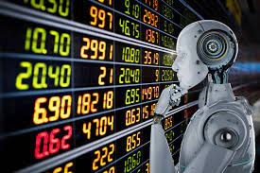
ChatGPT3 Market Risk Analyzer

Slide 2
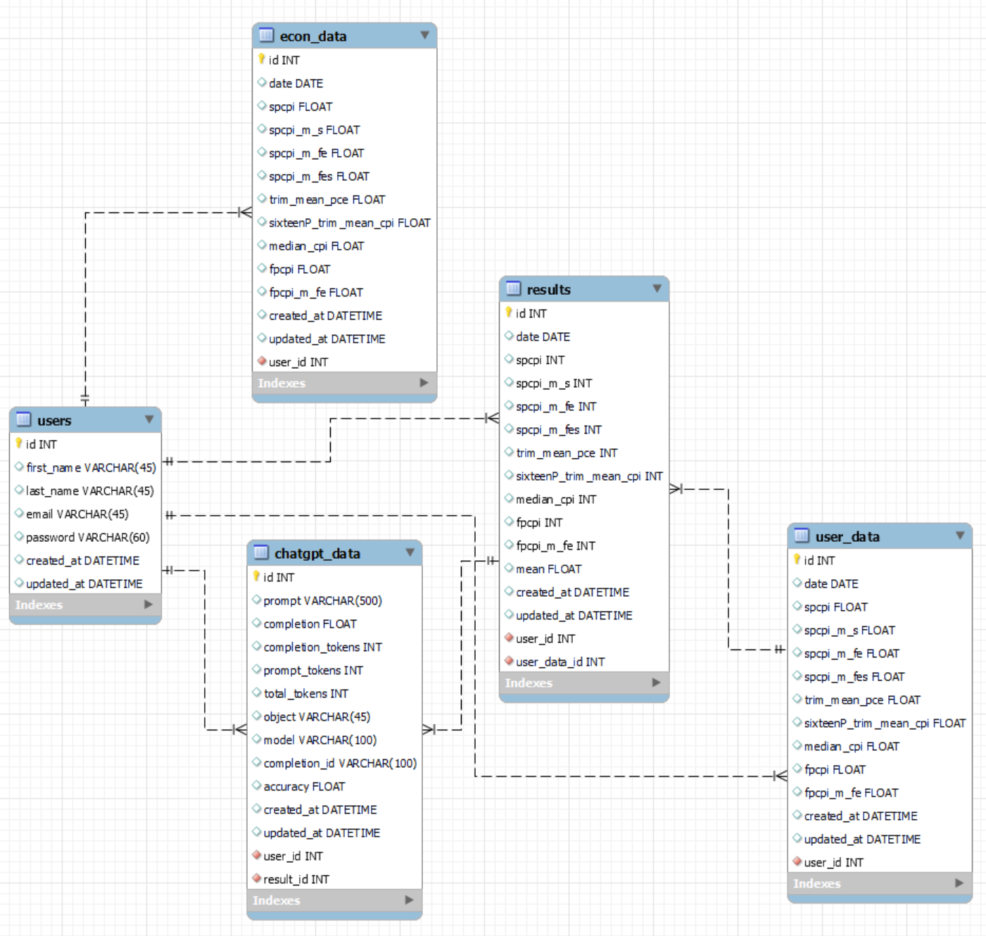
Entity Relationship Diagram (ERD)

Slide 3
Preparation
Downloaded, transformed, and filtered 9 datasets from FRED API via Python.
Performed normal distribution analysis using Pandas library on datasets.
Engineered algorithm that categorized each data point into normal percentiles based on historical normal distribution.
Programmatically created prompt/completion pair .jsonl file to create Fine Tune ChatGPT3 Model.
Trained ChatGPT3 Curie Model on 40 years of CPI, PCE, and Inflation data with distribution category as completion.

Slide 4
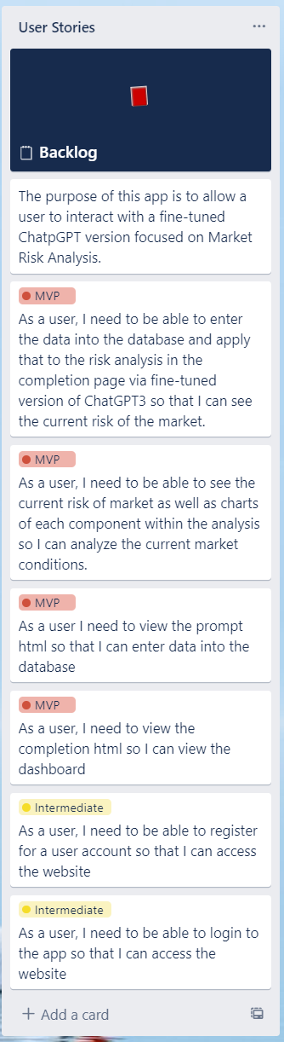
User Stories
User needs the ability to enter data points into database to create a prompt for ChatGPT3.
User needs the ability to view completion from ChatGPT3 on dashboard.
User needs the ability to view, explore, and navigate each data set included in this project.
User needs the ability to view the risk level of the market.
User needs the ability to view the accuracy rate of ChatGPT3’s completion response.
User Needs the ability to retrain the model based on accuracy results.

Slide 5
Backend Functionality
ChatGPT3 Model:
Save ChatGPT3 response
Retrain ChatGPT3
Create .jsonl files
Economic Data Model:
Create Plotly Chart
Get All Economic Data
Get Last Economic Data
Get Last Date From FRED API
Results Model:
Save Statistical Analysis Data,
Get All Results Data,
Get Last Analysis Results,
Get Last FRED API Analysis Result,
Risk Analysis Process,
Get Full Risk Report,
Create Plotly Guage Chart.
User Data Model:
Save User Data,
Get Last User Data.
User Model:
Save User,
Verify Email,
Get By Email,
Validate Name.
User Controller:
Reg (Bcrypt/Regex)
Login (Bcrypt/Regex)
Clear Session
User Data Controller
Create/Prompt
Prompt/Processing
Retrain
Dashboard

Slide 6

ChatGPT3 and I thank you!
Questions?
Contact me @ https://www.linkedin.com/in/njoyedevs

